Slide 1
A Study Of The Book Of Revelation
May 9, 2021

Slide 2

Revelation 16:16
Revelation 16
“And they gathered them together into the place which is called in Hebrew Har-Magedon.”

Slide 3
Battle of Armageddon
Revelation 16
Armageddon is the spiritual conflict!
Satan and his allies wage war against God and His saints. The kingdom of Christ and His disciples has never been, nor shall ever be, advanced by engaging in physical warfare (John 18:36; 2 Corinthians 10:4).
The sword used by God’s army is His word, the sword of the Spirit (Ephesians 6:10-18).

Slide 4
Battle of Armageddon
Revelation 16
Armageddon literally means “hill of Megiddo”
Derived from an actual place in the Valley of Jezreel
No literal “hill” or “mount of Megiddo”
Towns of Megiddo – Joshua 17:11; Judges 1:27
Waters of Megiddo – Judges 5:19
Valley of Megiddo – 2 Chronicles 35:22; Zechariah 12:11

Slide 5
Battle of Armageddon
Revelation 16
Mount Megiddo is a plain located between the Sea of Galilee and the Mediterranean Sea
Since not an actual literal place – This is not an actual literal battle.
The valley is somewhat triangular and is no more than 20 by 15 miles in size. It is only about 6 miles across the valley due north from Megiddo.
Megiddo overlooked the plain of Esdraelon and has been a strategic place in the history of God’s people. It is on the main road between Egypt and Mesopotamia.
Typically it is a battleground between the forces of good and evil.

Slide 6
Battle of Armageddon
Revelation 16
A number of ancient battles were fought there.
Barak and Deborah overthrew the kings of Canaan – Judges 5:19
Gideon defeated the Midianites. Judges 6:33
Saul defeated the Philistines. 1 Samuel 31:8
Ahaziah died of Jehu’s arrows. 2 Kings 9:27
Pharaoh-Necoh overthrew Josiah. 2 Kings 23:29-30

Slide 7
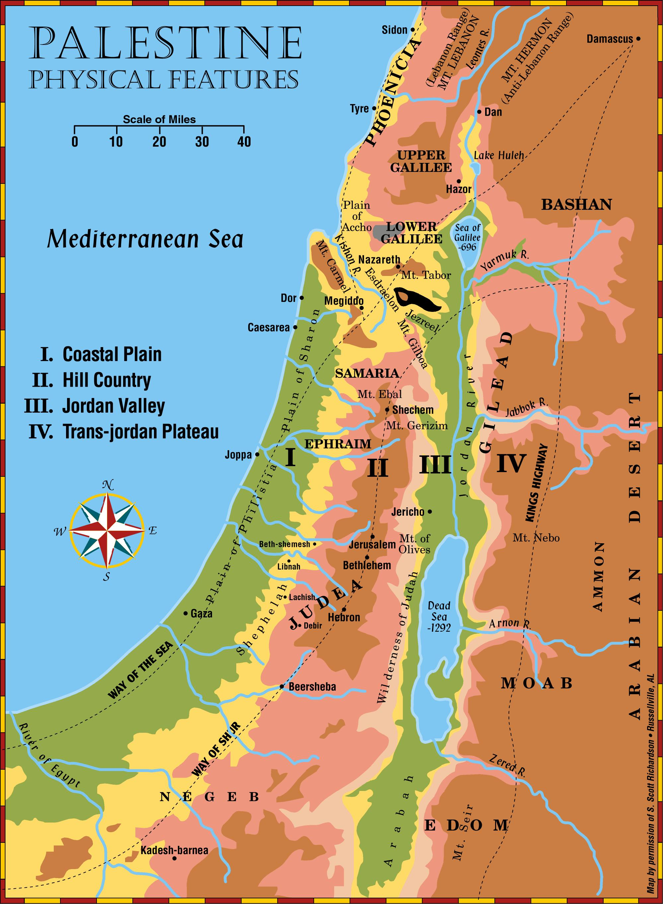
Megiddo

Slide 8
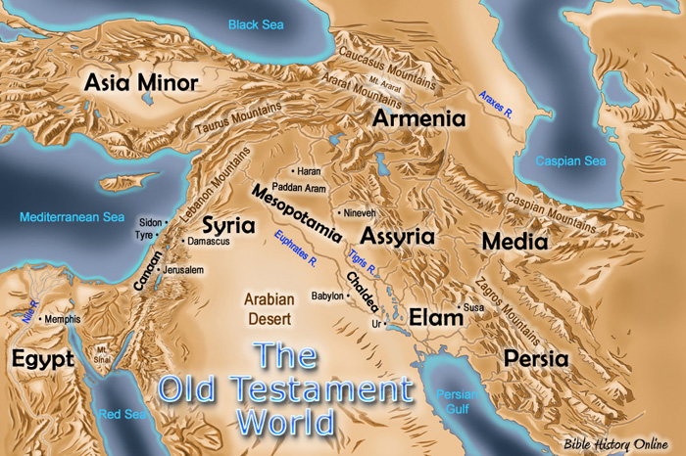
Strategically Located
Megiddo
Africa

Slide 9
Battle of Armageddon
Revelation 16
Remember, Revelation is filled with symbolic language
If this scene is literal instead of figurative – confusion results:
General appearance as frogs (16:13)
Physically impossible for army of 200 million horsemen to march in formation one mile wide and 85 miles long!
A great river of blood 200 miles long would not fit in the valley!

Slide 10
Battle of Armageddon
Revelation 16
The warfare is between the spiritual forces of righteousness and evil
God and Satan
Battle was fought and won by the Lord in the complete destruction of the Roman Empire.
The Lord will emerge as the victor in this drama. Revelation 19:19-21
Assure the saints the ultimate victory!

Slide 11
Battle of Armageddon
Revelation 16
Modern-day prophets frequently preach that this battle is …
Russia, Israel, and the United States
Other parties they figure into world events
Great world war ending, leading to the final return of the Son of God
Establishment of a kingdom on earth
Reign from Jerusalem for 1,000 years
Battle is not ahead of us in our history – but behind us!

Slide 12
Revelation 16:17
Revelation 16
“And the seventh poured out his bowl upon the air; and there came forth a great voice out of the temple, from the throne, saying, It is done”

Slide 13
The Seventh Bowl Poured out
Revelation 16
The air is smitten
“It is done – it is finished!”
The judgment has been completed
Final bowl of divine wrath is emptied
Final judgment coming down on Rome
Voice came from heaven, from the throne – a divine pronouncement!

Slide 14
Revelation 16:18
Revelation 16
“and there were lightnings, and voices, and thunders; and there was a great earthquake, such as was not since there were men upon the earth, so great an earthquake, so mighty.”

Slide 15
Revelation 16:19
Revelation 16
“And the great city was divided into three parts, and the cities of the nations fell: and Babylon the great was remembered in the sight of God, to give unto her the cup of the wine of the fierceness of his wrath.”
Revelation 11:8; 14:8
Revelation 14:10

Slide 16
Revelation 16:20
Revelation 16
Revelation 6:14;
Ezekiel 26:18
“And every island fled away, and the mountains were not found.”

Slide 17
Revelation 16:21
Revelation 16
“And great hail, (every stone) about the weight of a talent, cometh down out of heaven upon men: and men blasphemed God because of the plague of the hail; for the plague thereof is exceeding great.”

Slide 18
Seventh Bowl God’s Exclamation Point!
Revelation 16
After that announcement there were:
Lightnings
Thunderings
Great earthquake
Like none other that had ever appeared on the earth
The epitome of horror
Judah at hand of Nebuchadnezzar (Ezekiel 5:8-9)
Jews at hand of Rome (Matthew 24:21)
Destruction of a mighty great nation!
From Revelation 8:3-5
Incense added to the prayers of the saints. Censer filled with fire taken from the altar.
Fire strikes the earth, causing thunder, voices, lightning, and an earthquake – all symbolic of God’s response.
All this expresses certainty that God hears and answers the prayers of His people. (cf. Revelation 6:9-11; Exodus 2:23-24; 1 Peter 3:12; 1 Peter 2:5; 1 Timothy 2:5; 1 Thessalonians 5:17; Philippians 4:6).
God warns first – then comes judgment! Amos 3:3, 7; 2 Peter 3:9
Now God’s judgment is certain!

Slide 19
Seventh Bowl God’s Exclamation Point!
Revelation 16
Summary:
The division of the great city into three parts points to completeness of the destruction
All nations fell who were in the league with Rome with opposition to God
Weakened and divided – easily conquered!
No place of refuge – even islands and remote mountains removed
Cup of wrath and its fierceness – Great power magnified!

